Slide 1

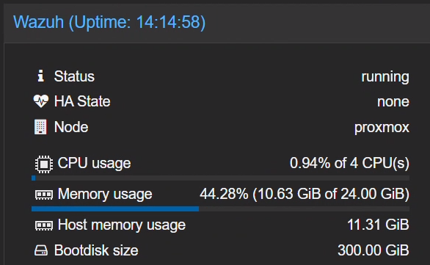
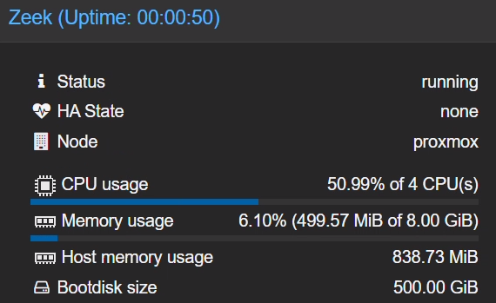

Network security monitoring with Wazuh and Zeek| Wazuh 4.14.3
Wazuh-server
OS: Ubuntu 22.04
CPU: 4 Cores.
RAM: 16GB (Minimum).
Disk: 500GB or larger.
Server Requirements / 系統需求
Zeek-server
OS: Ubuntu 22.04
CPU: 4 Cores.
RAM: 8GB (Minimum).
Disk: 500GB or larger.
Thien.dinh （丁德善 ）

Slide 2

I. Introduce
-Network security focuses on ensuring the integrity, confidentiality, and availability of computer networks and data by preventing unauthorized access, misuse, or disruption. Continuous network monitoring provides visibility into network activity, enabling organizations to detect issues, optimize performance, and identify potential threats before they escalate into serious incidents.
-Wazuh is an open source SIEM/XDR platform that monitors, detects, and responds to security threats across endpoints, networks, and cloud environments in real time. Zeek, on the other hand, is a Linux-based open source framework for network visibility that analyzes traffic and produces structured logs and artifacts describing observed activity.
-By ingesting Zeek logs, Wazuh enriches them with security context and applies correlation, alerting, and automated response actions. Integrating Zeek with Wazuh delivers unified, actionable visibility into network events and strengthens an organization’s ability to detect, investigate, and respond to security threats.
we demonstrate how to integrate Zeek with Wazuh for unified network security monitoring.

Slide 3
I. Zeek log analysis
By default, Zeek outputs logs in a tab-separated values (TSV) format, where each type of log (such as conn.log, dns.log, etc.) has its own unique set of fields. These fields are not standardized across all log types. We perform the following to make Zeek logs easier to analyze and integrate with Wazuh:
+ Parse and normalize: Convert Zeek native log files into JSON.
+ Map fields: Translate Zeek-specific field names and values into standard names and values that match your organization’s schema or requirements.
+ Enrich as needed: Add timestamps, event types, or other metadata to add context to Zeek events.

Slide 4
Use cases
Wazuh can parse Zeek logs and generate alerts using custom or built-in rules. Sample detection capabilities include:
You can configure Wazuh to generate alerts based on thresholds, frequency, and known indicators of compromise (IoCs) by leveraging rules and CDB lists.
Threat type | Zeek log | Description
Brute-force attack | conn.log | Detects repeated failed login attempts based on connection patterns.
Denial-of-service (DoS) attack | conn.log | Identifies flooding traffic from a single source.
Reconnaissance scan | conn.log | Tracks port scans and network probes using unusual traffic patterns.
DNS query | dns.log | Flag queries to known malicious or suspicious domains.
SSL/TLS certificate threats | ssl.log | Flag connections to servers with self-signed or expired certificates.

Slide 5
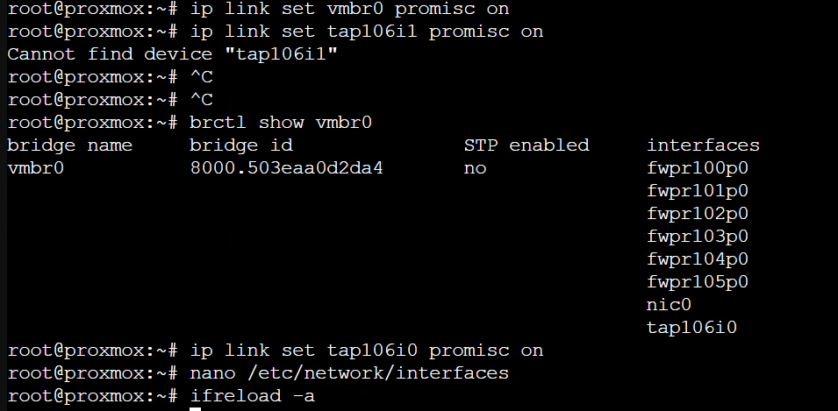
Internet POE -> router -> switch unmanagement-> proxmox (Vnet vmbr0)-> + Zeek server ubuntu
+ Wazuh server ubuntu
+ v.v
Proxmox (Virtual Port Mirroring)
ip link set vmbr0 promisc on
ip link set tap106i0 promisc on ->ID 106 Zeek server

Slide 6
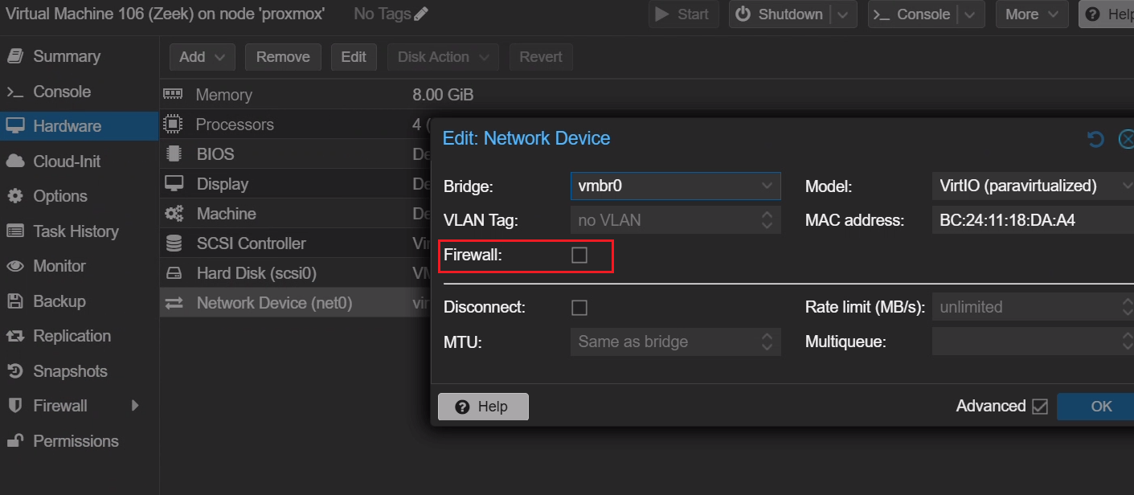
Internet POE -> router -> switch unmanagement-> proxmox (Vnet vmbr0)-> + Zeek server ubuntu
+ Wazuh server ubuntu
+ v.v
VM Zeek Ubuntu Config
1. Disable Firewall
Zeek server -> Hardware-> Network device -> uncheck firewall
sudo ip link set ens18 promisc on -> ifconfig check name: my zeek server ens18
root@zeeksv:/home/zeeksv# sudo tcpdump -i ens18 -n -> check traffic
tcpdump: verbose output suppressed, use -v[v]... for full protocol decode
listening on ens18, link-type EN10MB (Ethernet), snapshot length 262144 bytes
03:47:12.268746 IP 192.168.210.19.22 > 192.168.210.203.63154: Flags [P.], seq 3838245531:3838245739, ack 2623342484, win 501, length 208
03:47:12.325328 IP 192.168.210.203.63154 > 192.168.210.19.22: Flags [.], ack 208, win 509, length 0
03:47:12.352100 IP 192.168.210.19.22 > 192.168.210.203.63154: Flags [P.], seq 208:512, ack 1, win 501, length 304

Slide 7
Internet POE -> router -> switch unmanagement-> proxmox (Vnet vmbr0)-> + Zeek server ubuntu
+ Wazuh server ubuntu
+ v.v
Lab Data Flow Diagram Traffic
1.from the Internet via Router to Unmanaged Switch.
2.Data enters Proxmox via the physical port connected to vmbr0. vmbr0 (in Promisc mode) copies the data and sends it to the Zeek virtual machine.
3. Zeek parses and logs JSON.
4. Wazuh Agent on the same Zeek machine reads the logs and pushes them to the Wazuh Server (also located on Proxmox).

Slide 8
Configuration
Perform the steps below to configure this integration.
Ubuntu endpoint
Perform the following steps on the Ubuntu endpoint:
Install Zeek
Configure Zeek
Configure log monitoring in the Wazuh agent

Slide 9
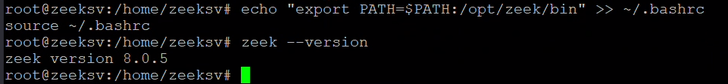
Install Zeek
Follow the steps below to install Zeek on the Ubuntu endpoint.
Note
You need administrative privileges to execute all the commands described below
1. Run the command below to add the Zeek repository:
echo 'deb http://download.opensuse.org/repositories/security:/zeek/xUbuntu_22.04/ /' | sudo tee /etc/apt/sources.list.d/security:zeek.list
2. Download and add the GPG key for the Zeek repository:
curl -fsSL https://download.opensuse.org/repositories/security:zeek/xUbuntu_22.04/Release.key | \
gpg --dearmor | sudo tee /etc/apt/trusted.gpg.d/security_zeek.gpg > /dev/null
3. Update the repository index and install Zeek using the following command:
sudo apt update -y
sudo apt install zeek –y
4. Add the /opt/zeek/bin directory to the system path through the ~/.bashrc file, then reload the ~/.bashrc file to apply the changes:
echo "export PATH=$PATH:/opt/zeek/bin" >> ~/.bashrc
source ~/.bashrc
5. Verify the installed Zeek version:
zeek --version

Slide 10
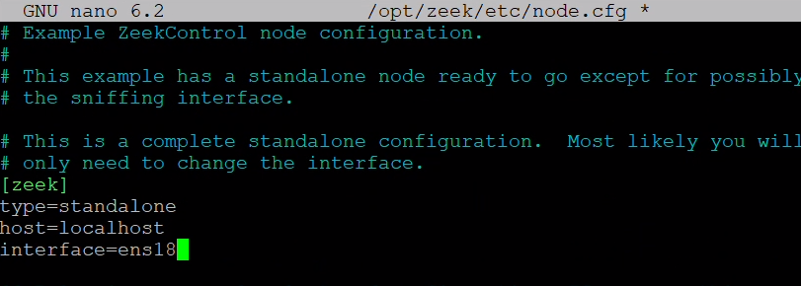
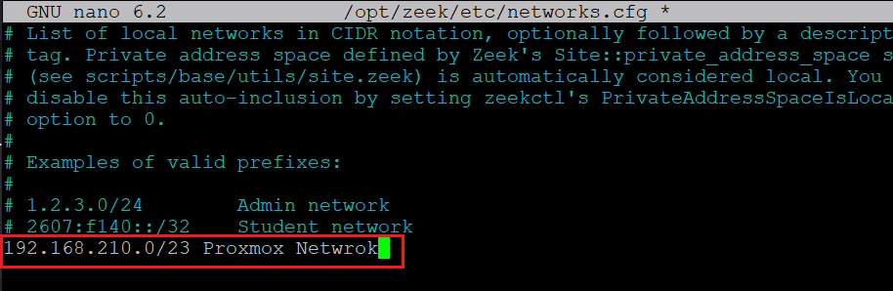
Configure Zeek
Follow the steps below to configure Zeek.
1. Edit the /opt/zeek/etc/node.cfg file and set the packet capture interface. In this lab proxmox , use ens18: please use ifconfig check
2. Edit the /opt/zeek/etc/networks.cfg file and add your network subnet. Add with your network subnet. The content of the file will look similar to this:

Slide 11
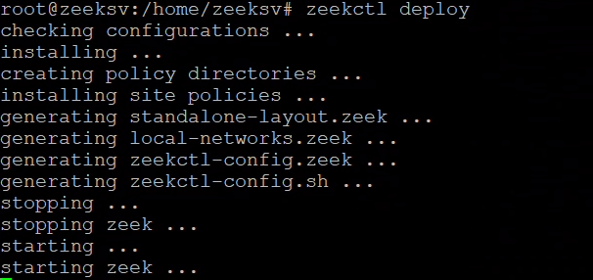

Configure Zeek
3. Run the following command to verify your Zeek syntax:
zeekctl check
Output
Hint: Run the zeekctl "deploy" command to get started.
zeek scripts are ok.
4. Start Zeek:
zeekctl deploy
5. Enable JSON log output. Zeek logs are stored in TSV format by default. Add the following line to the /opt/zeek/share/zeek/site/local.zeek file to generate logs in JSON: @load policy/tuning/json-logs.zeek
6. Restart Zeek to apply the changes: zeekctl deploy
Zeek logs such as conn.log and dns.log will now be generated in JSON format in the /opt/zeek/logs/current directory.

Slide 12
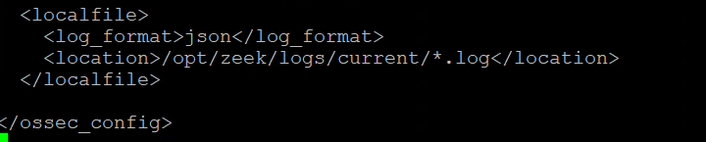
Configure log monitoring in the Wazuh agent
1. Modify the /var/ossec/etc/ossec.conf file and append a localfile entry for all Zeek JSON logs at the end of the file:
2. Restart the Wazuh agent to apply the configuration changes:
systemctl restart wazuh-agent

Slide 13
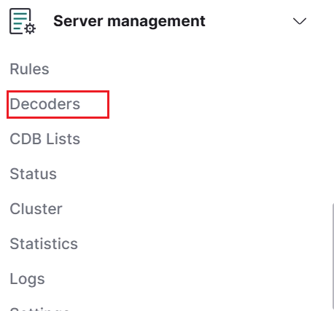
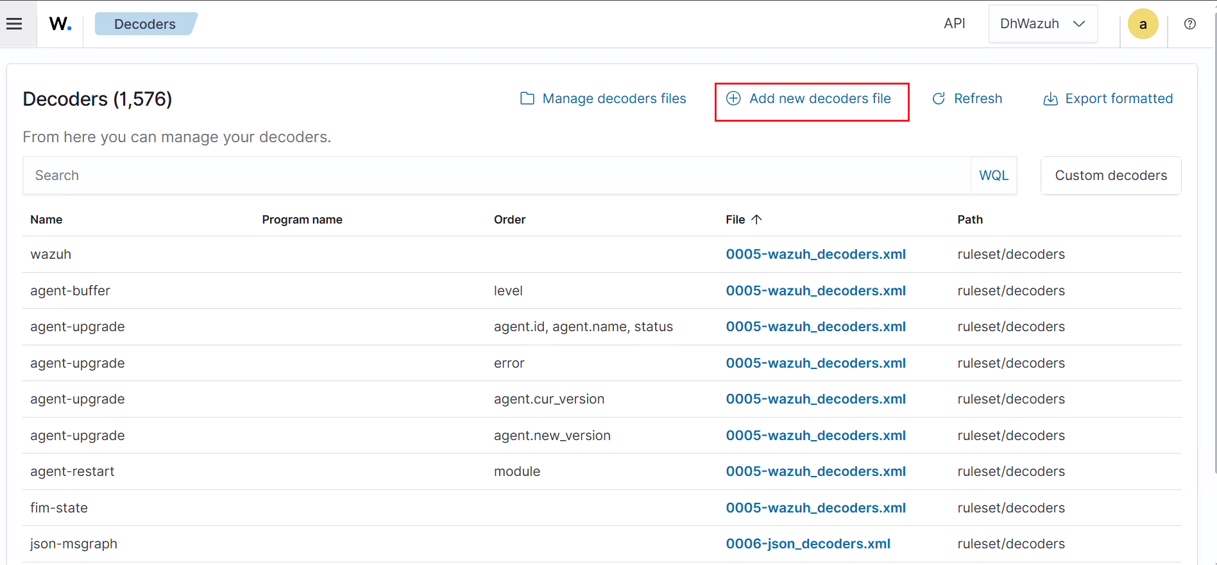
Wazuh dashboard
Perform the following steps on the Wazuh dashboard.
Create custom decoders and rules
Perform the steps below to create and configure custom decoders and rules for processing and monitoring logs generated from Zeek.
1. Navigate to Server management > Decoders.
2. Click + Add new decoders file.

Slide 14
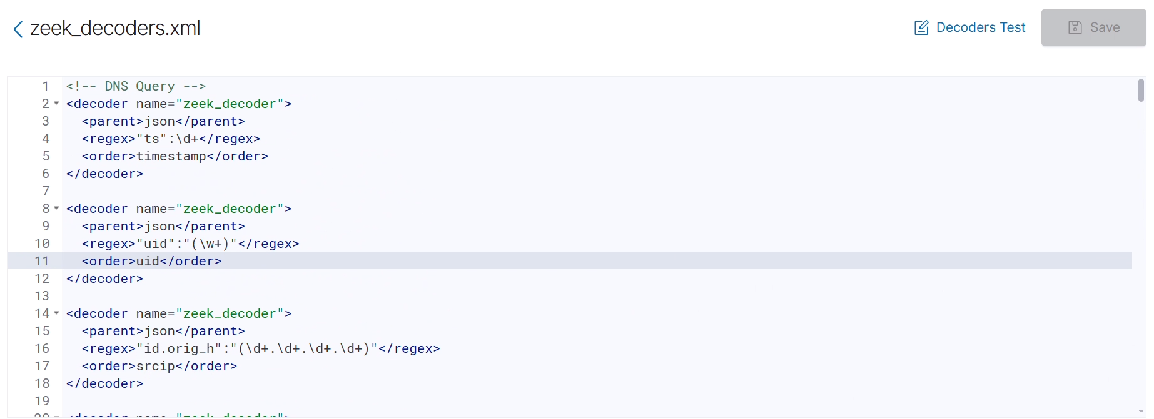
Wazuh dashboard
Perform the following steps on the Wazuh dashboard.
Create custom decoders and rules
Access link copy code
https://github.com/ddthien-coder/zeekxml/blob/develop/zeek_decoders.xml

Slide 15
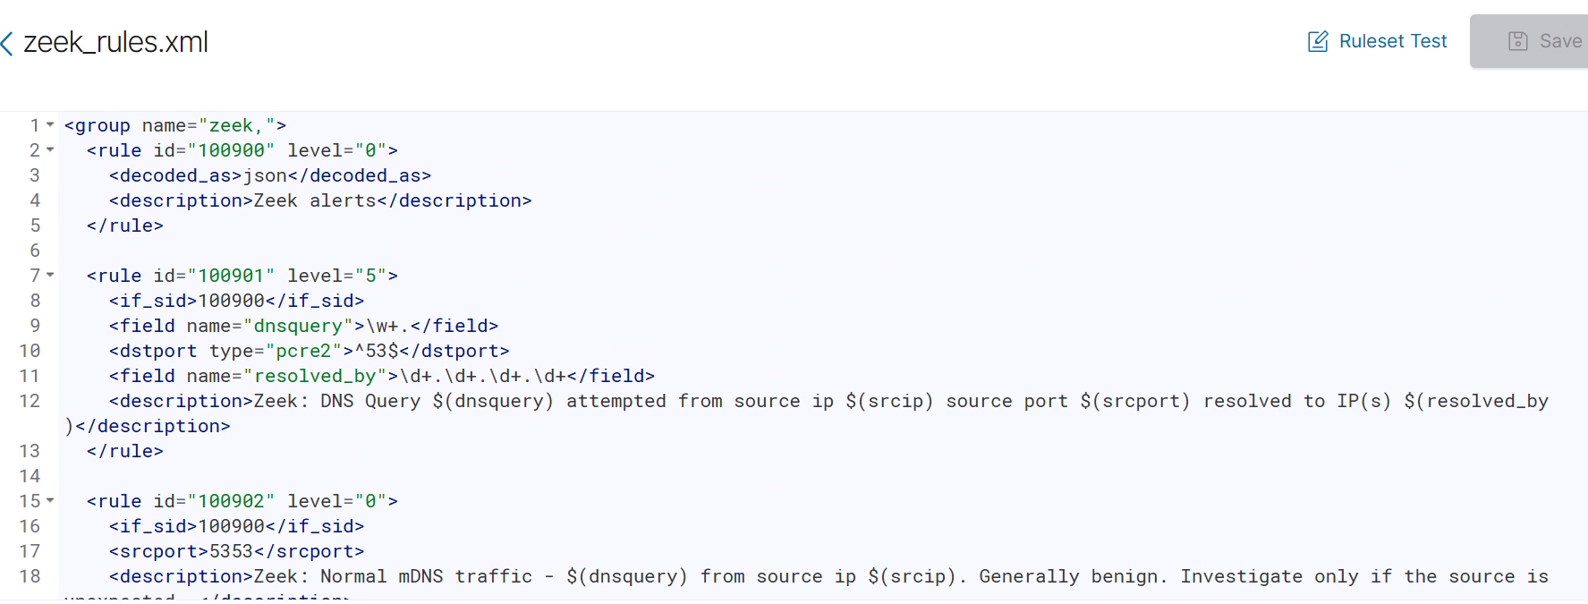
Wazuh dashboard
Perform the following steps on the Wazuh dashboard.
Create custom decoders and rules
4. Navigate to Server management > Rules.
5. Click + Add new rules file.
6. Copy and paste the rules below and name the file zeek_rules.xml. Click Save.
https://github.com/ddthien-coder/zeekxml/blob/develop/zeek_rules.xml

Slide 16
Testing the integration
We test the following use cases to validate the integration of Zeek with Wazuh:
DNS queries
Reconnaissance and port scanning activity
SSL/TLS certificate validation threats
Perform the following steps to test the integration and view alerts on the Wazuh dashboard.
DNS queries
We simulate DNS queries on the Ubuntu endpoint. Run the following commands to generate DNS query logs.
dig wazuh.com
dig virustotal.com
Detection results
Follow the steps below to view the alerts generated on the Wazuh dashboard once the attack attempt is completed.
Threat Hunting, and click the Events tab.

Slide 17
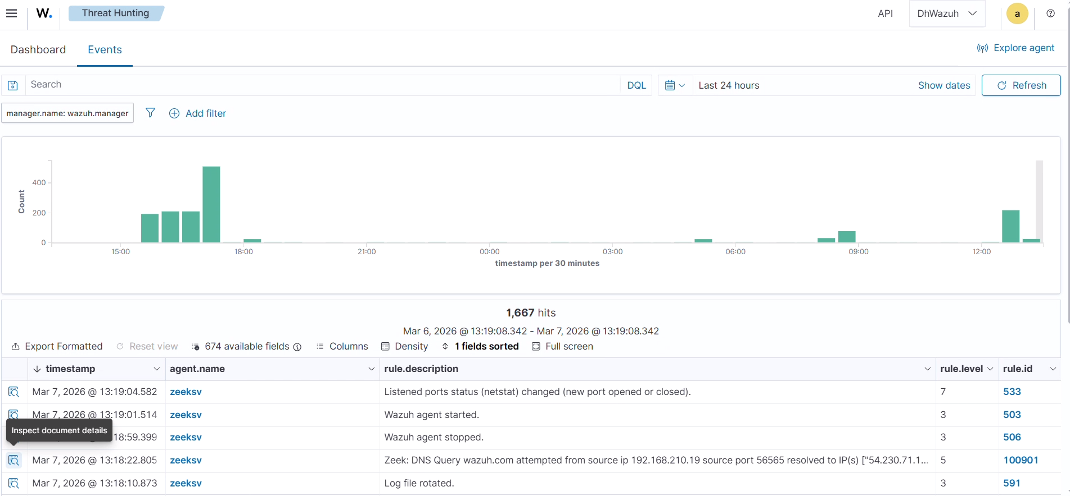

Slide 18



